Slide 1
3.3 Training Our Model
Notes:
In this section we are going to look at some of the computer vision and AI technology used in self driving cars, specifically an approach to predict the steering angle based on a feed of images of the road ahead.

Slide 2
Training our model
Creating training, validation and test datasets
Keras neural network definition
Generators
Analysing our model’s performance
Notes:
This slide, like mentioned above is for multiple pointers. The information above covers the types of information that can be used in this slide

Slide 3
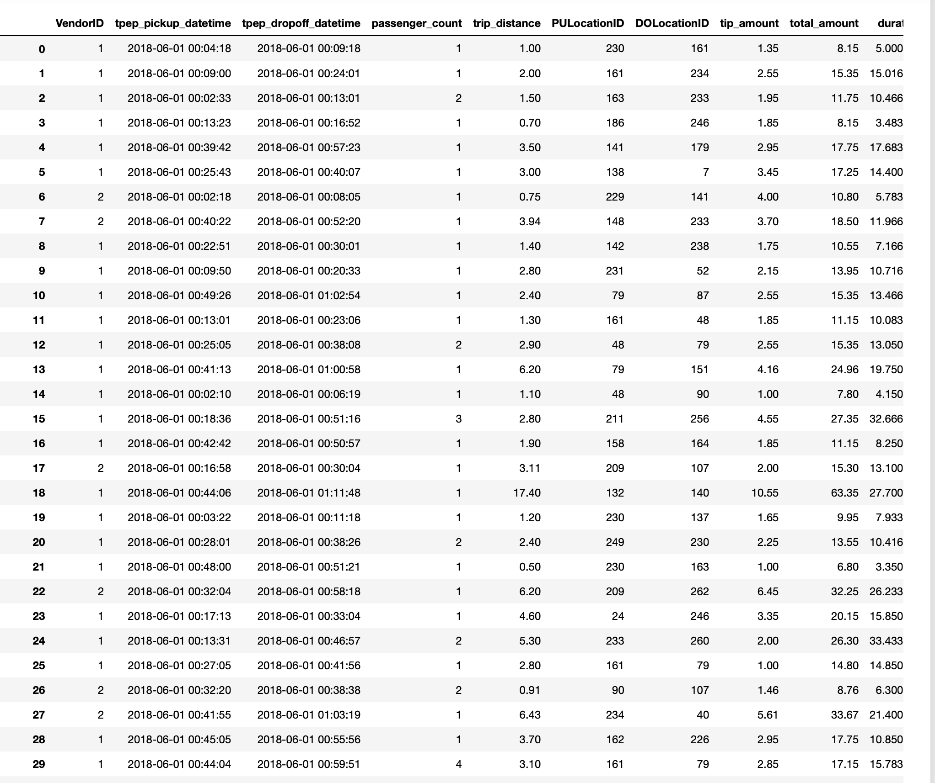
Splitting our data into train, validate and test datasets
Training Samples
Validation Samples
Test
Samples
Notes:
For this exercise, I’ve split the data using a typical approach.
60% of the data is for training
20% for validation (which is to help the training algorithm)
20% is kept out for testing our model (we’ll use this in the next video).
This slide shows an example of what this would look like. Obviously our real data is circa 8m rows long and contains more columns (or features) than are displayed here.

Slide 4
Generators
As our dataset is large, we don’t want to load it all into memory
Generators give us the ability to iterate through our dataset and train on batches
Notes:
As our dataset is large, we don’t necessarily want to load it all into memory in one go, or even pass it to the neural network in one go. We’ll use Keras generators to split the data up into batches and feed it to the network as and when the training algorithm needs more samples.

Slide 5
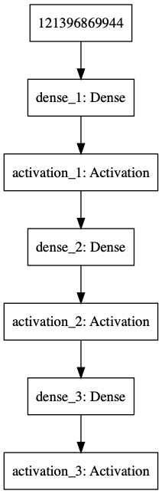
Our Neural Network
Sample
Prediction of Trip Duration
Notes:
Our neural network is quite simple in comparison to some that are widely used. It has 3 layers, an input layer connected to a fully connected (or dense) layer of 8192 neurons, a 2nd layer with 1024 neurons (again fully connected) and a final output layer.

Slide 6
Let’s explore the code…
Notes:
As you can see, a large percentage of the dataset has a steering angle of between -5 and +5 degrees. This can potentially cause training issues where the algorithm may get 70% accuracy by just returning 0 as the answer! Obviously this won’t be a good thing in a real car!!

Slide 7
Debugging Neural Networks
Training neural networks can be more trial-and-error than science
Prove the code works by running a small number of samples and a single batch
Train using a small number of samples to check that the model converges and you see overfitting
Increase the number of samples over time
Make changes to the network architecture, hyper-parameters, etc. to find an optimal solution
Then scale to the full dataset
See https://keras.io/getting-started/faq/#why-is-the-training-loss-much-higher-than-the-testing-loss
Notes:
This is the approach I use for training neural networks. Typically I would perform the initial training and tuning locally to ensure the code is working and the model is starting to converge or a small number samples before moving to a cloud based server to train on the full dataset.

Slide 8
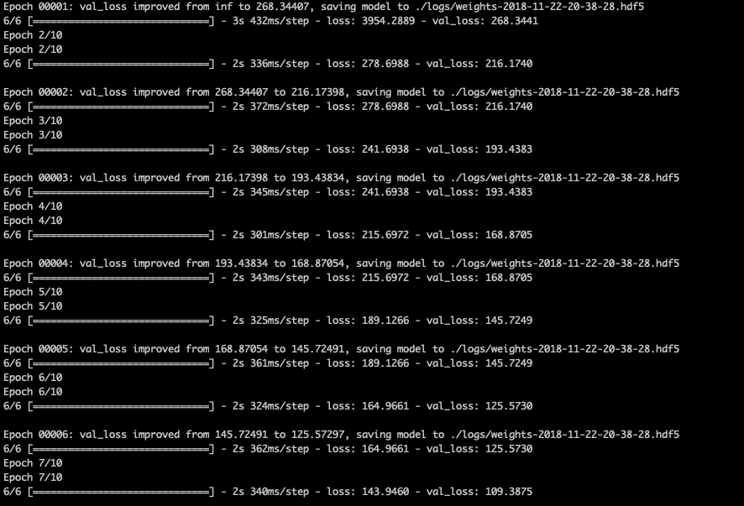
Analysing Training Performance
We are looking for the [training] loss and validation loss to decrease over time
python3 train.py
Notes:
Here you can see the command used to train the model.
The output from the training shows a small sample run, but it demonstrates training and validation losses decreasing, which is what we want to achieve.

Slide 9
Predicting Journey Times
Notes:
In the next video we’ll use our model to predict journey times

